Slide 1


Infant Learning Program
Services From Newborn to 36 Months

Slide 2

What is ILP?
The Infant Learning Program (ILP) at the Tanana Chiefs Conference (TCC) is a home-based early intervention program that provides support and services to young children experiencing developmental delays and their families. This program is family centered, meaning that each child is viewed in the context of their entire family and Community. Family goals and needs are the center of services.
The ILP program at TCC serves Interior Alaska – along the road system and the interior villages served by TCC. Services are provided to any child birth to three, that resides outside of the Fairbanks North Star Borough. Children do not have to be Tribal members.
The Infant Learning Program was designed to be the foundation of the education system that serves children with special needs through Part C of the Individuals with Disabilities Education Act. ILP facilitates transitions to pre-school, Head Start and special education.

Slide 3
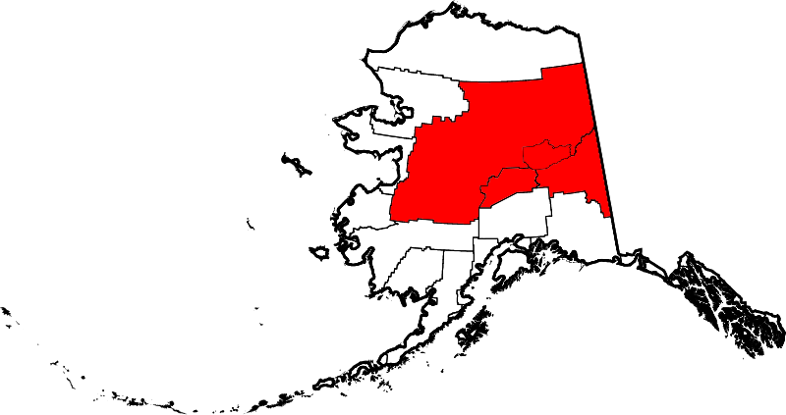
What communities does TCC ILP serve?
Road Communities Upper Tanana Yukon Koyukuk
Anderson Dot Lake Galena
Healy Eagle Huslia
Cantwell Tanacross Kaltag
Mentasta Lake
Healy Lake Koyukuk
Lower Yukon Northway Nulato
Anvik Tetlin Ruby
Grayling Tok Yukon Tanana
Holy Cross Yukon Flats Alatna Tanana
Shageluk Arctic Village Allakaket
Kuskokwim Beaver Evansville
McGrath Birch Creek Hughes
Medira Canyon Village Lake Minchumina
Nikolai Chalkyitsik Manley Hot Spring
Takotna Circle MInto
Telida Fort Yukon Nenana
Venetie Rampart
Stevens Village

Slide 4

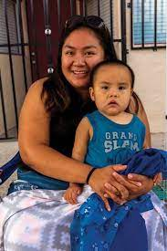
What Does ILP Offer
Developmental Screenings and Evaluations
Family Support and Service Coordination
Special Instruction and information for Caregivers
Direct Speech, Occupational and Physical Therapy
Referrals to Appropriate Supports and Resources in the Community
Transition Services in to Pre-school, Head Start and Special Education as Children approach age three.

Slide 5

Where Do We Start?
Infants and young children, ages birth to three can be referred to the program through:
Healthcare providers
Parents and Caregivers
Child Protection
Community Educators or Service Providers
**Anyone can make a referral with parental consent.**

Slide 6
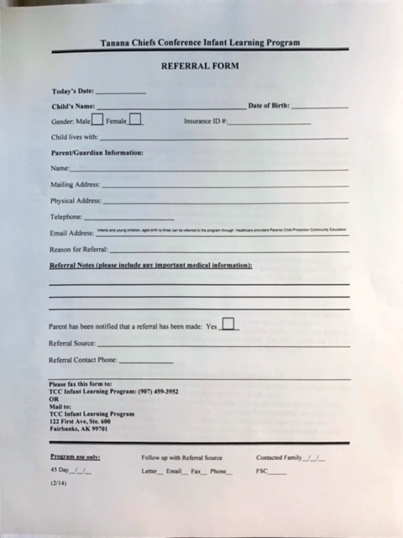
What Information is Needed?
Child’s full Name and Birthday
Parents Names and contact information
Reason for referral/concerns for development
Diagnosis if appropriate
Referral Source /name/contact information
Parental Consent/Parent Notification

Slide 7
Who Is the Team?
Developmental Specialist from the Infant Learning Program
Speech and Language Pathologist
Occupational Therapist
Physical Therapist
Parents and Caregivers
Home visitors and Service Providers from other family support programs and community resources
*** Teams are familiar with Infant Mental Health and Wellness and trauma informed practices.***

Slide 8
What are the roles of People on the Team?
Parents and Caregivers- primary service providers, all plans, goals and services are carried out with the parents consent and input. Parents play an active role in services and therapies.
Developmental Specialist (from the Infant Learning Program) – a specialized professional who will offer activities, developmental information, advice and support for the family. They will assist the family in accessing all the resources and services needed.
Family Service Coordinator (From the ILP) – suggests resources and services the family may access, coordinates team meetings and family appointments, documents contact and services, develops IFSP with the family and team.
Speech and Language Pathologist – evaluates and treats speech and communication issues including expressive and receptive communication, feeding and swallow difficulties and motor, muscle planning for communication
Occupational Therapist – evaluates and treats skill development used for everyday life activities including sensory integration and regulation skills
Physical Therapist – evaluates and treats muscle movement and skills needed to move the body around, maintain stability, coordination and mobility

Slide 9
What Is an IFSP?
IFSP is the acronym for Individual Family Service Plan. When all of the information is gathered from family intake interviews, medical records and other service records, screenings, and evaluations, it is used to develop a service plan and goals that are specific to the needs of each child and their family.
The IFSP is the agreement between the family and ILP about the services that will be provided. The IFSP outlines who, when, where and how often services are provided. All services and activities are designed to fit into a child and family’s everyday routines and interests.
Goals in the IFSP guide the services and reflect the family’s desires, interests and values with regard to their child and their own family life.

Slide 10
Who Do We Contact?
Tanana Chief’s Conference Infant Learning Program Staff
Gina M. Pope Lori Markkanen
Infant Learning Program Developmental Specialist
(907) 452- 8251 ext. 3176 (907)452-8251 ext. 3280
Gina.pope@tananachiefs.org Lori.markkanen@tananachirfs.org
Fax: (907) 459-3952 Fax: (907) 459-3952

Slide 11

Funding Sources:
Senior and Disability Services

